Slide 1

Interfacing GPS module with Beaglebone Black Wireless Project : IOT BASED SMART PARKING USING BEAGLEBONE BLACK WIRELESS
SUBMITTED BY:
JOYAL RAJU (C0749019)
Group #1

Slide 2

Contents
Introduction.
Interfacing GPS module with Beaglebone black wireless.
Connection details
Coding steps
Output
Hardware circuit
References.

Slide 3
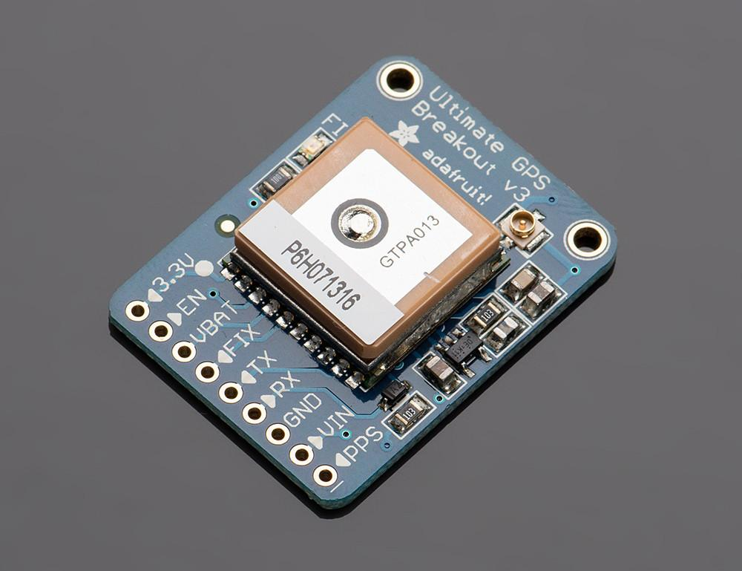
Introduction
Adafruit ultimate GPS breakout module can receive information from GNSS satellites and then calculate the device’s geographical position
It have -165 dBm sensitivity, 10 Hz updates, 66 channels
Working voltage: 3.3v to 5v
Working current: 20mA
Position Accuracy: 1.8 meters
This is used to update the position of parking station

Slide 4
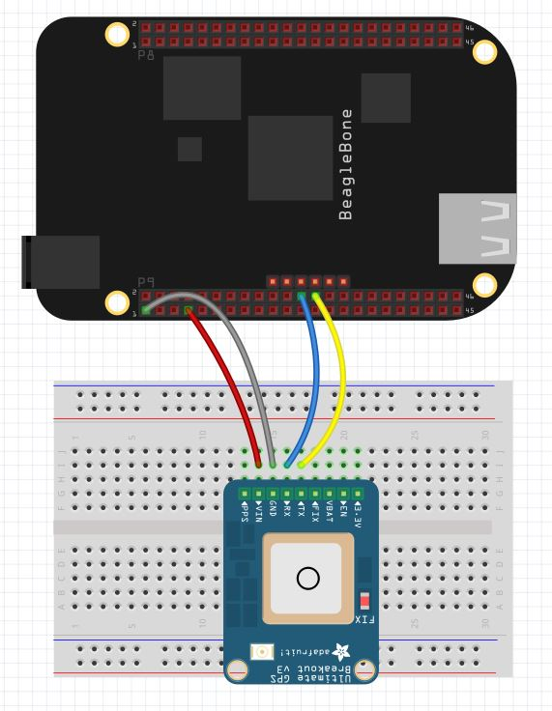
Interfacing GPS module with Beaglebone Wireless
The working voltage of GPS module ranges between 3.3 V to 5V and the beaglebone is 3.3V device.
Interfacing of adafruit ultimate gps breakout module with BBB wireless is done by using jumper wires
Baud rate should be 9600 while communication
Output will be in the form of NMEA sentences that contain the position, altitude and velocity data

Slide 5
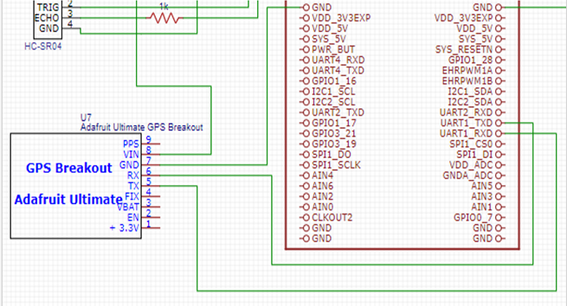
Connection details
RX pin of GPS module is connected to UART1_TXD pin of beaglebone black wireless.
TX pin of GPS module is connected to UART1_RXD pin of beaglebone black wireless.
From the GPS module Vin is connected to the power supply and GND to the GND of beaglebone wireless

Slide 6
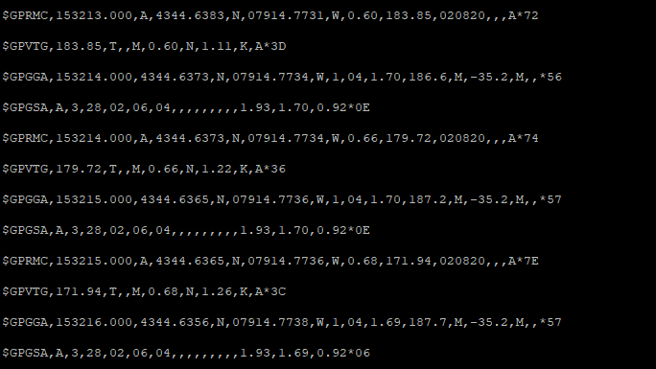
NMEA raw data
NMEA is a standard data format used by all GPS manufacturers.
All NMEA messages start with the $ character, and each data field is separated by a comma.
Different kinds of NMEA sentences are available, $GPRMC (Global Positioning Recommended Minimum Coordinate) and the $GPGGA sentences.
$GPRMC sentence contains most of the data required.

Slide 7
Contd..
First field gives time in UTC with hhmmss format.
Next field gives the status of the connection. ‘A’ denotes active connection, ‘V’ denotes void connection.
Next field gives latitude of device
Forth one gives latitude hemisphere, N for North and S for South
Next one gives longitude of the device
Sixth one gives longitude hemisphere, W for West and E for East
Next data gives ground speed in knots, here it is 0.60
One after that gives the date in ddmmyy format

Slide 8
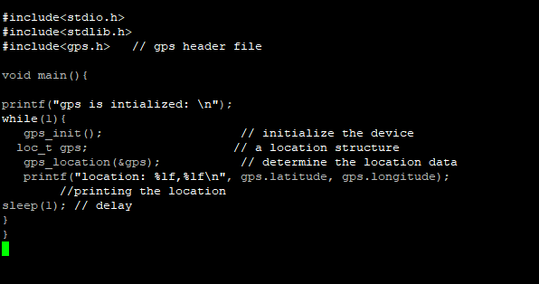
Coding steps
“gps.h” library is added to decode the raw data from GPS module
GPS library is initialized using ‘gps_init()’ command
Location structure is created using ‘loc_t gps’
‘gps_location(&gps)’ command will decode the data from GPRMC line and store decoded data to gps structure accordingly

Slide 9
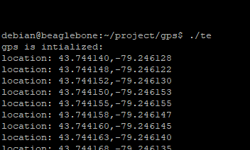
Output

Slide 10
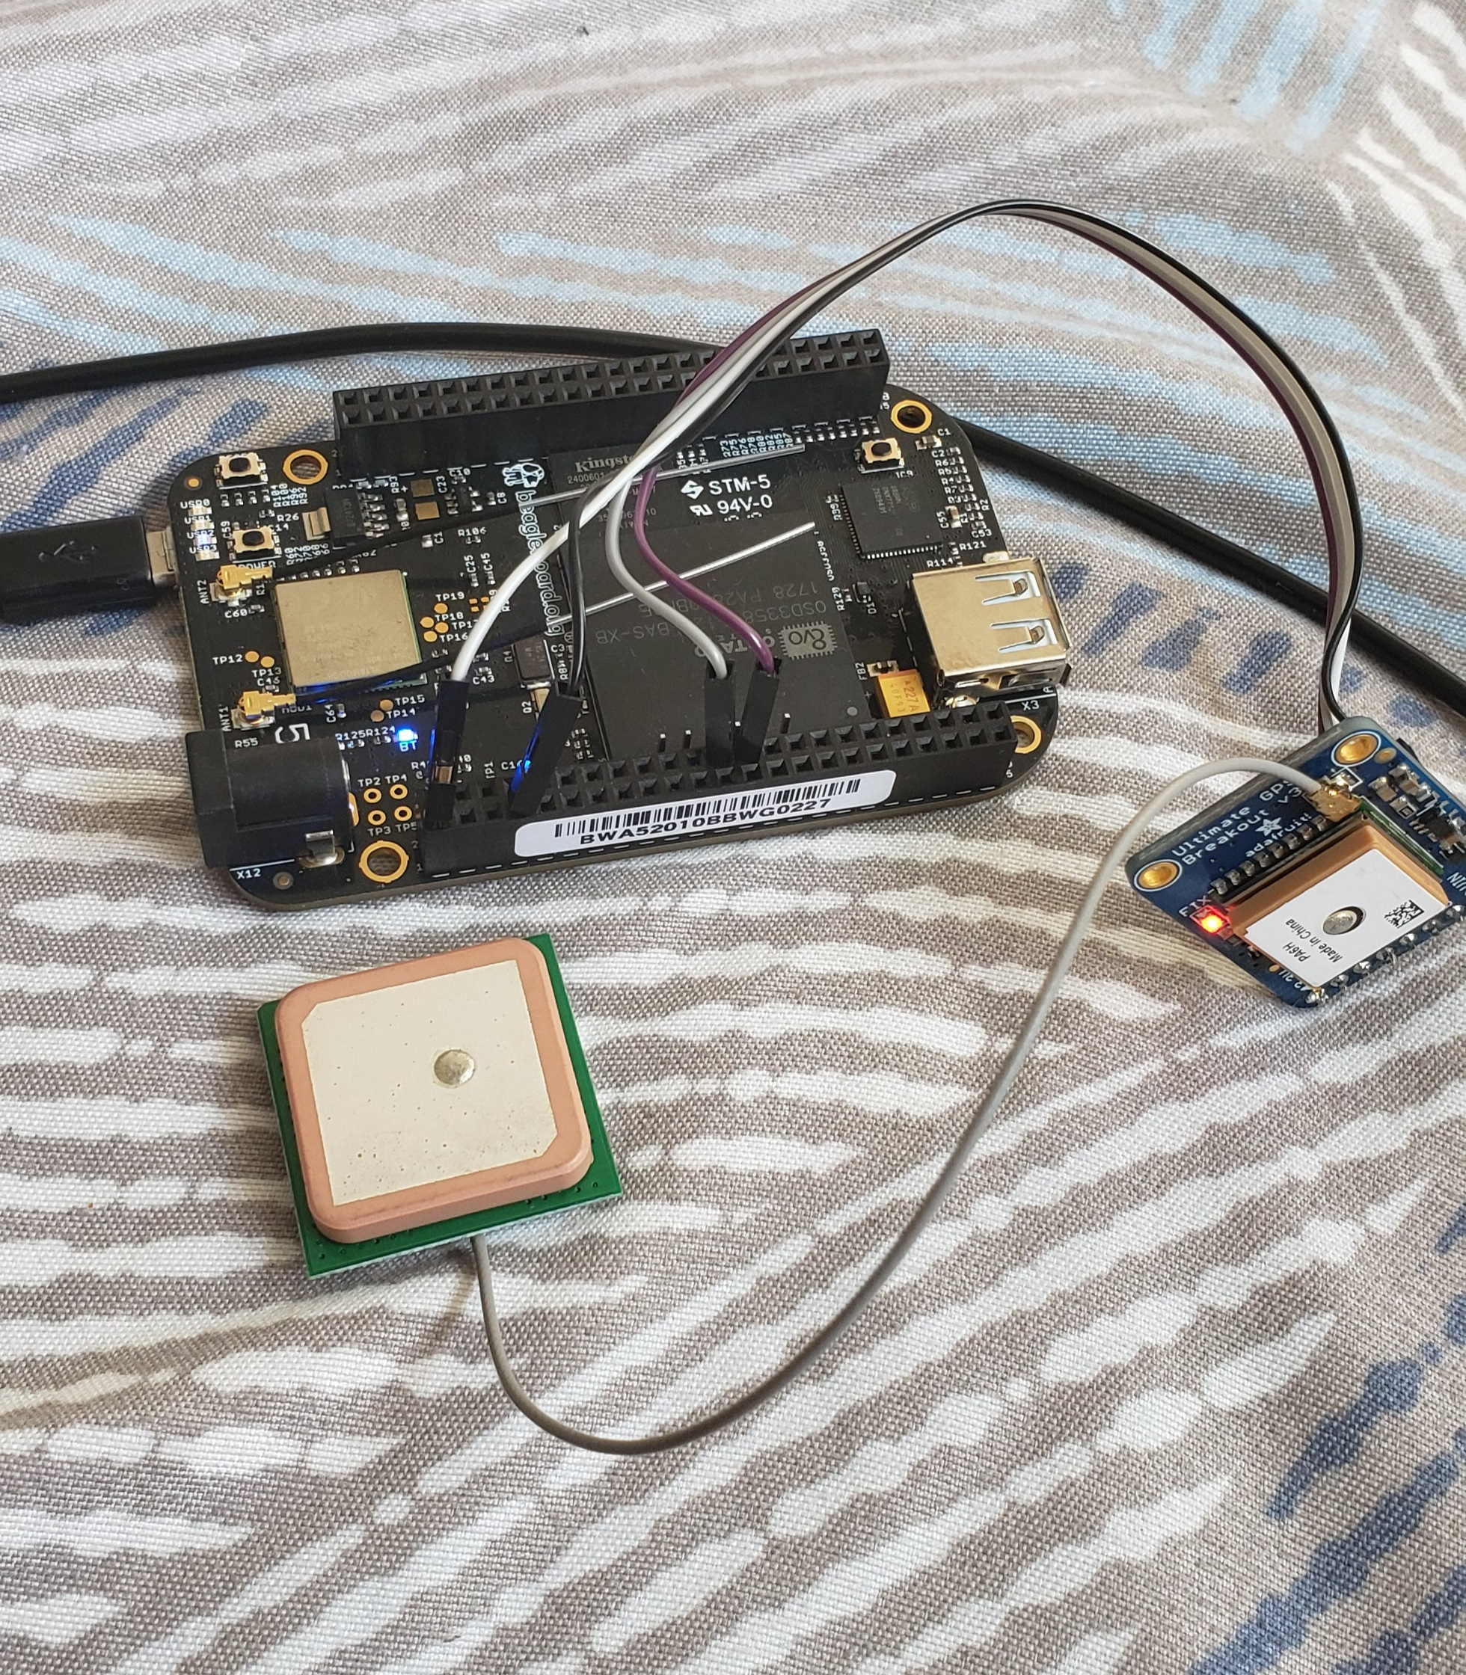
Hardware circuit

Slide 11
REFERENCES
Adafruit (ND). Adafruit ultimate gps breakout - 66 channel w/10 hz updates retrieved from: https://www.adafruit.com/product/746
Paul McWhorter (2015). Beaglebone black GPS lesson 1: hooking up the adafruit ultimate GPS retrieved from: https://toptechboy.com/beaglebone-black-gps-lesson-1-hooking-up-the-adafruit-ultimate-gps/
Erik Gakstatter (2015). What exactly is GPS NMEA data? retrieved from: https://www.gpsworld.com/what-exactly-is-gps-nmea-data/

